Slide 1

ADITYA ENGINEERING COLLEGE (A)
BIRD SPECIES IDENTIFICATION FROM IMAGE
Batch No :9
Under the guidance of:
Ms. G. Aparna, M. Tech
Sr.Assistant Professor
Department of CSE
Aditya Engineering College (A)
Team Members:
PATI YASWITHA SRILAXMI (16A91A0537)
PEDAPUDI THANUJA (16A91A0539)
SAMUDRALA AKHIL(16A91A0546)
M.P.V. SAI DURGA REDDY (16A91A0529)

Slide 2
ABSTRACT
Aditya Engineering College (A)
Identification of bird species is a challenging task often resulting in ambiguous labels. Even professional bird watchers sometimes disagree on the species given an image of a bird. It is a difficult problem that pushes the limits of the visual abilities for both humans and computers. Although different bird species share the same basic set of parts, different bird species can vary dramatically in shape and appearance. Our project .aims to employ the power of deep learning to help amateur bird watchers identify Bird species from the images they capture.

Slide 3
EXISTING SYSTEM
Aditya Engineering College (A)
In this system bird species are identified manually.
Bird watchers or researchers are used to watch the birds to find the specie of bird.
It is done by observing features like color, family, wing, feather etc.
DRAWBACKS:
Since many decades, bird watchers or researchers are facing problems in bird species identification manually.
There will be some mismatches during identification of species because of same similarities.
It is a time consuming process.

Slide 4
PROPOSED SYSTEM
Aditya Engineering College (A)
This system deals with identification of bird species from image.
To develop such system a bird dataset is required to classify an image.
CNN algorithm take input image, assign importance to various objects and differentiate one from the other.
The result obtained were of high efficiency as the software could easily identify a bird species from an image whose database was present in the database.
ADVANTAGES
Image Recognition, Bird identification will be simple.
Pre trained algorithms made feature extraction possible from image.

Slide 5
Software Specifications
Aditya Engineering College (A)
Platform: Windows or Linux.
Front End: HTML & CSS
Programming language: Machine learning
Algorithm: CNN
Back End: TensorFlow
Module: Keras

Slide 6
Why Tensor Flow?
Aditya Engineering College (A)
TensorFlow is an end-to-end open source platform for machine learning. It has a comprehensive, flexible ecosystem of tools, libraries and community resources that lets researchers push the state-of-the-art in ML and developers easily build and deploy ML powered applications.
Easy model building: Build and train ML models easily using intuitive high-level APIs like Keras with eager execution, which makes for immediate model iteration and easy debugging.
Robust ML production anywhere: Easily train and deploy models in the cloud, on-prem, in the browser, or on-device no matter what language you use.

Slide 7
KERAS
Aditya Engineering College (A)
Keras is a central part of the tightly-connected TensorFlow 2.0 ecosystem, covering every step of the machine learning workflow, from data management to hyperparameter training to deployment solutions.
Keras supports almost all the models of a neural network – fully connected, convolutional, pooling, recurrent, embedding, etc. Furthermore, these models can be combined to build more complex models.
Keras, being modular in nature, is incredibly expressive, flexible, and apt for innovative research.
Keras is a completely Python-based framework, which makes it easy to debug and explore.
Modules used in keras are:
preprocessing module: Keras data preprocessing utils
layers module: Keras layers API
class Sequential: Sequential groups a linear stack of layers into a tf.keras.Model.

Slide 8
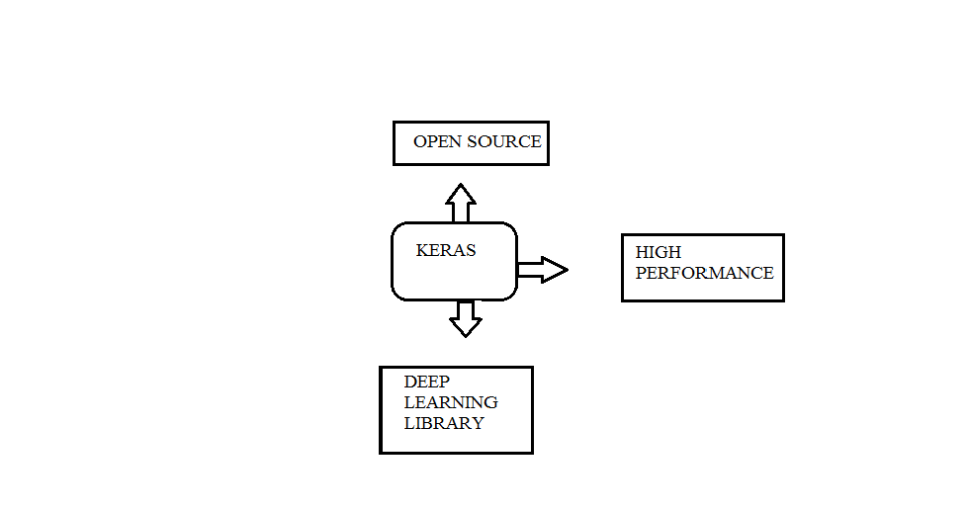
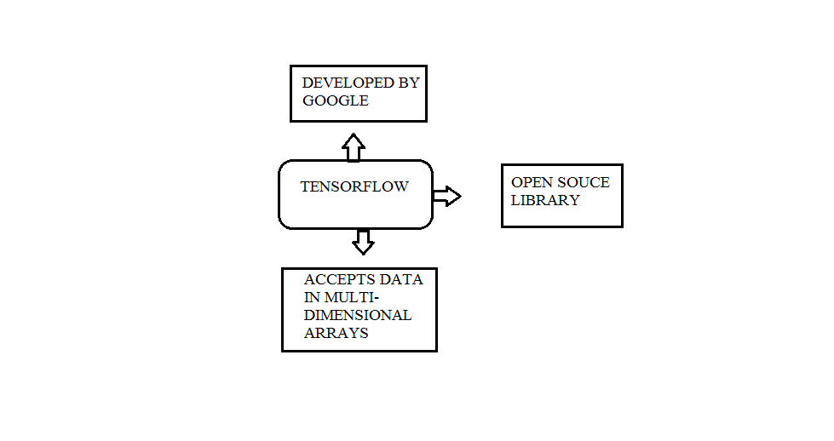
Aditya Engineering College (A)

Slide 9
HOW IMAGE RECOGNITION WORKS?
Aditya Engineering College (A)
Image recognition is the process of identifying and detecting objects and trained subjects through use of algorithms and deep learning concepts.
It is done by using convolution neural network.

Slide 10
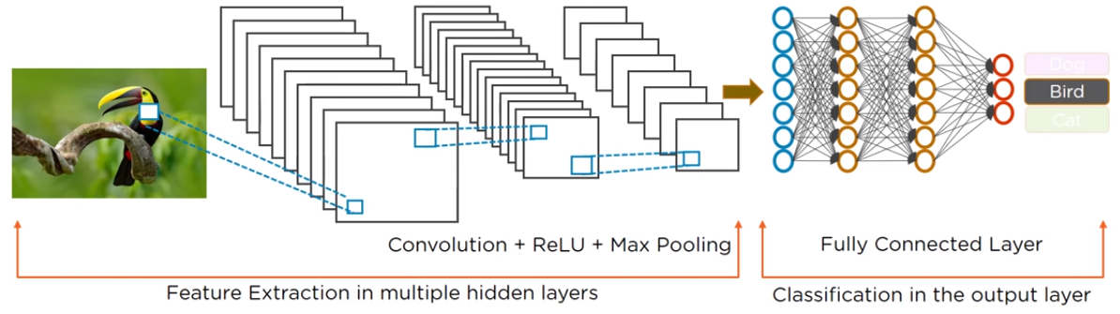
CONVOLUTIONAL NEURAL NETWORK
Aditya Engineering College (A)
The convolutional neural network (CNN) is a class of deep learning neural network commonly used in image recognition.
CNN has an input layer, hidden layers, and output layer.

Slide 11
Aditya Engineering College (A)
INPUT LAYER
Input layer accepts pixels of an image as input.
HIDDEN LAYERS
Hidden layers carry out feature extraction. There are multiple hidden layers like convolution, relu, and Pooling layer.
OUTPUT LAYER
Fully connected layer is output layer identifies the image.

Slide 12
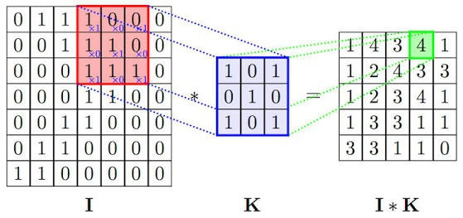
CONVOLUTION LAYER
Aditya Engineering College (A)
A convolution layer has number of filters that perform convolution operation.
This layer uses a matrix filter to detect patterns in image.
A convolution is a linear operation that involves the multiplication of a set of weights with the input, much like a traditional neural network.

Slide 13
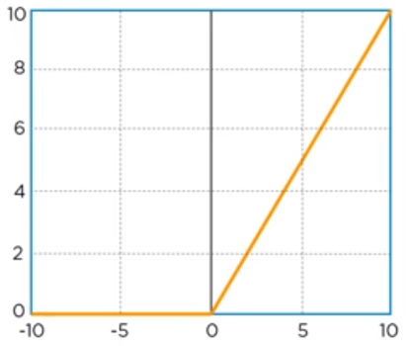
RELU LAYER
Aditya Engineering College (A)
The ReLU layer applies the function f(x) = max(0, x) to all of the values in the input volume. In basic terms, this layer just changes all the negative activations to 0.

Slide 14
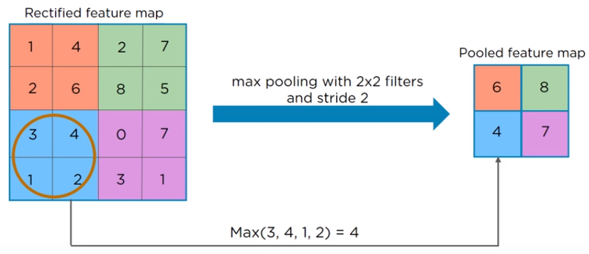
POOLING LAYER
Aditya Engineering College (A)
Pooling layer uses multiple filters to detect edges, corners, eyes, feather, beak etc.
This basically takes a filter (normally of size 2x2) and a stride of the same length. It then applies it to the input volume and outputs the maximum number in every subregion that the filter convolves around.

Slide 15
FULLY CONNECTED LAYER
Aditya Engineering College (A)
Fully connected layer is output layer that identifies object in image.

Slide 16
FLASK
Aditya Engineering College (A)
Flask is a web framework. This means flask provides you with tools, libraries and technologies that allow you to build a web application. This web application can be some web pages, a blog, a wiki or go as big as a web-based calendar application or a commercial website.

Slide 17
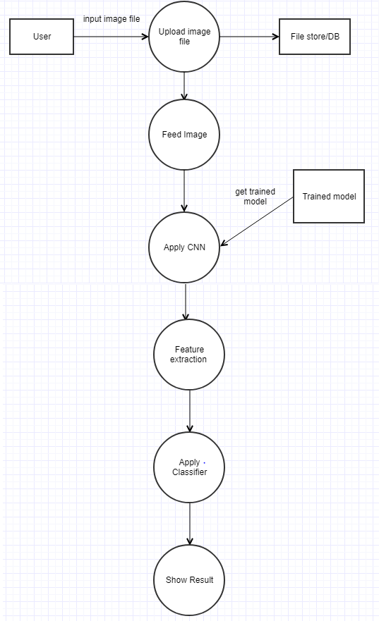
PROCESS STEPS
Aditya Engineering College (A)

Slide 18
UML DIAGRAMS
Aditya Engineering College (A)
USE CASE:

Slide 19
SEQUENCE:
Aditya Engineering College (A)

Slide 20
Activity :
Aditya Engineering College (A)

Slide 21
Hardware Requirements
Aditya Engineering College (A)
RAM: 4GB
Hard Disk: 1TB HDD

Slide 22

Home page:
Aditya Engineering College (A)

Slide 23
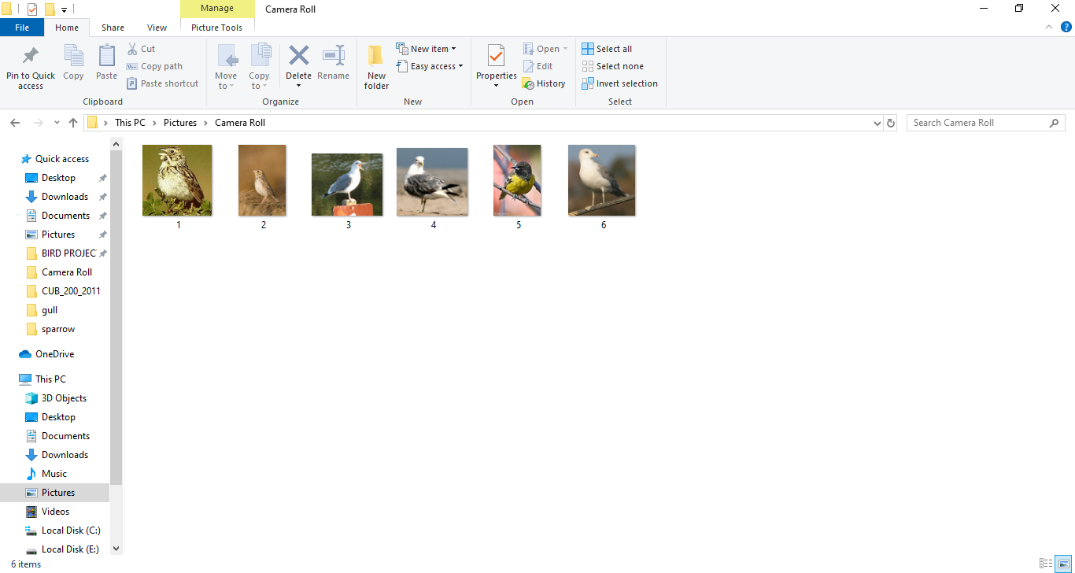
Navigate to database:
Aditya Engineering College (A)

Slide 24
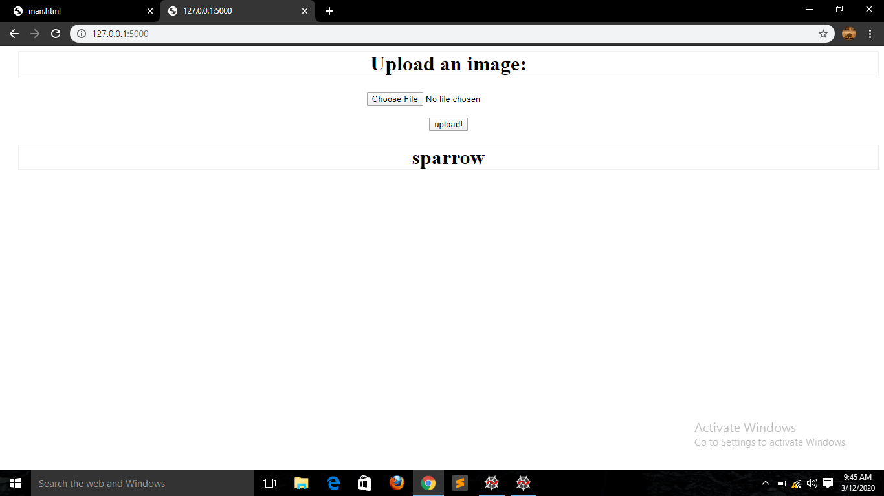
OUTPUT:
Aditya Engineering College (A)

Slide 25
FUTURE SCOPE
Aditya Engineering College (A)
Create an android/iOS application instead of website which will be more convenient to user.
System can be implemented using cloud which can store large amount of data for comparison and provide high computing power for processing (in case of Neural network)

Slide 26
References
Aditya Engineering College (A)
https://www.ijert.org/bird-species-identification-using-deep-learning
https://www.kaggle.com/burgoine/classification-of-birds

Slide 27
Conclusion
Aditya Engineering College (A)
To identify bird species using the deep learning methods for classification of image. The design CNN algorithm is suitable solution for classification and to get good accuracy.
The generated system is connected with a user-friendly website where user will upload photo for identification purpose and it gives the desired output.
Using this project we can easily identify species of a bird from the image that we captured
The accuracy of our algorithm is 95.09

Slide 28

ANY QUERIES?

Slide 29

Thank you..!

